Slide 1
Computation & Data Science at the Heart of a 21st Century University
David Culler & Cathryn Carson
University of California, Berkeley
2016 MSDSE Data Science Summit

Slide 2
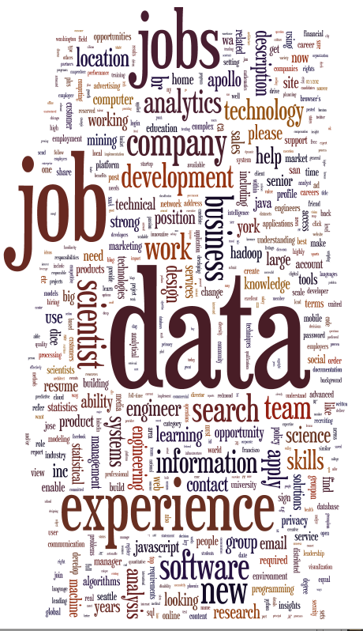
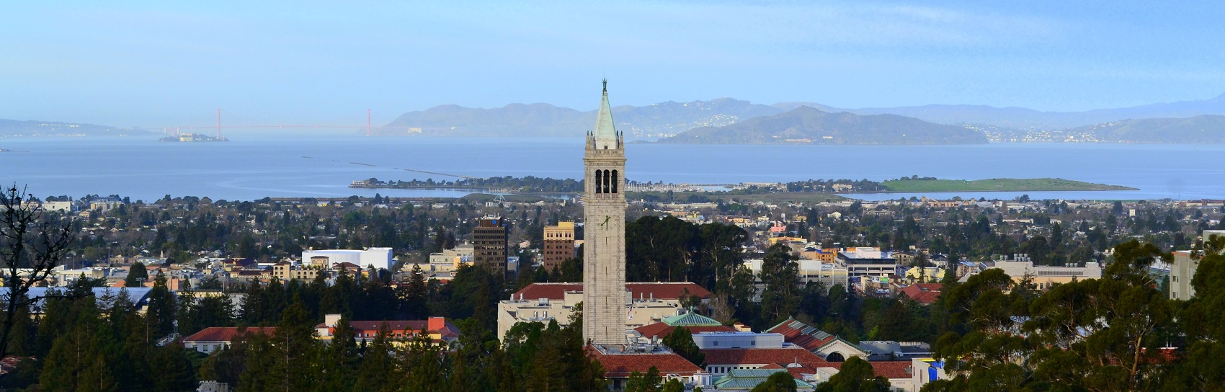
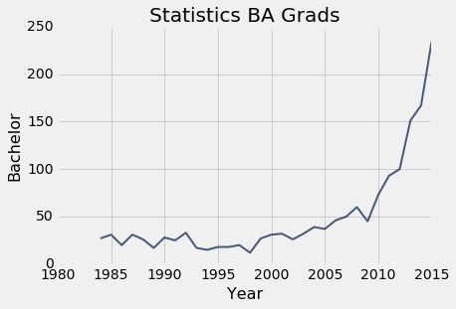
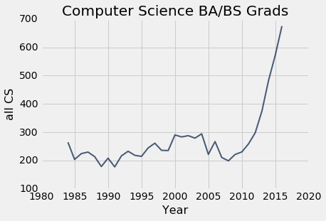
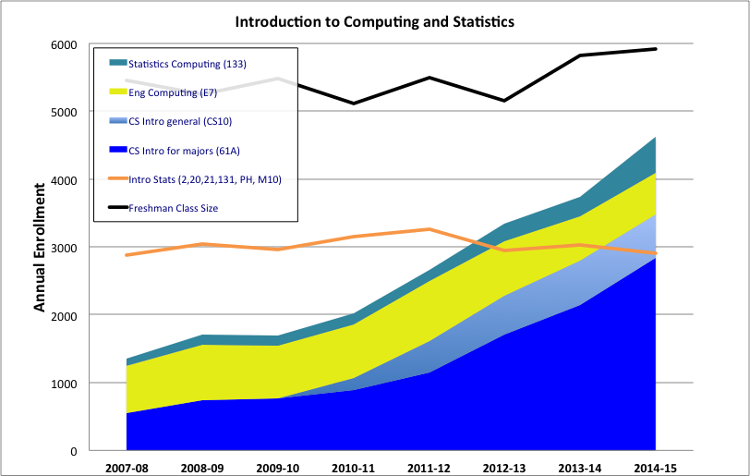

Vectors of Change

Slide 3
Refactoring an Institution
College of Letters & Science
Engineering
Professional Schools
Compu-tational
& Data Sciences & Eng.
Arts & Humanities
Social Sciences
Biological Sciences
Math & Physical Sciences
•••
Notes:
DEC

Slide 4













Connections, Core, & Networks
Data Science
For Smart Cities
Data and Ethics
Children in the Developing World
Data Science, Demography & Immigration
Social Networks
Comp. Structures in Data Science
Social Data Revolution
Probability and Math Stats in Data Science
Making Sense of Cultural Data
Data Science and the Mind
Genomics and Data Science
Data Science for Cognitive Neuroscience
data.berkeley.edu
Notes:
DEC

Slide 5
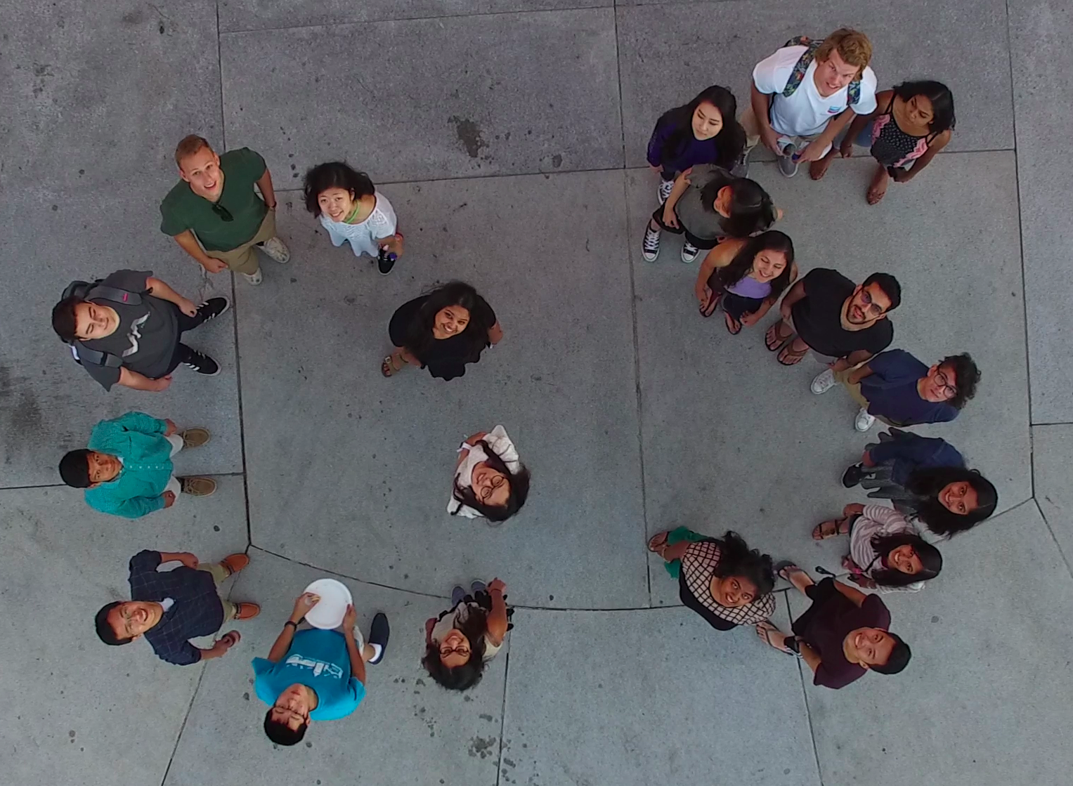
Designing for the Future
Notes:
DEC

Slide 6
Thanks
Notes:
DEC

